Slide 1
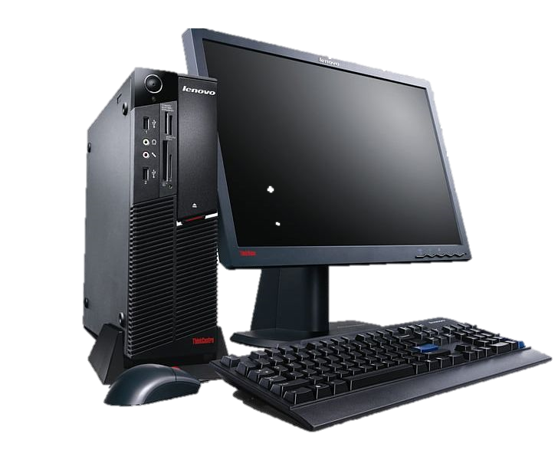
PCY webshop
Készítette: Paulusz Zsombor és Bodnár Bence

Slide 2
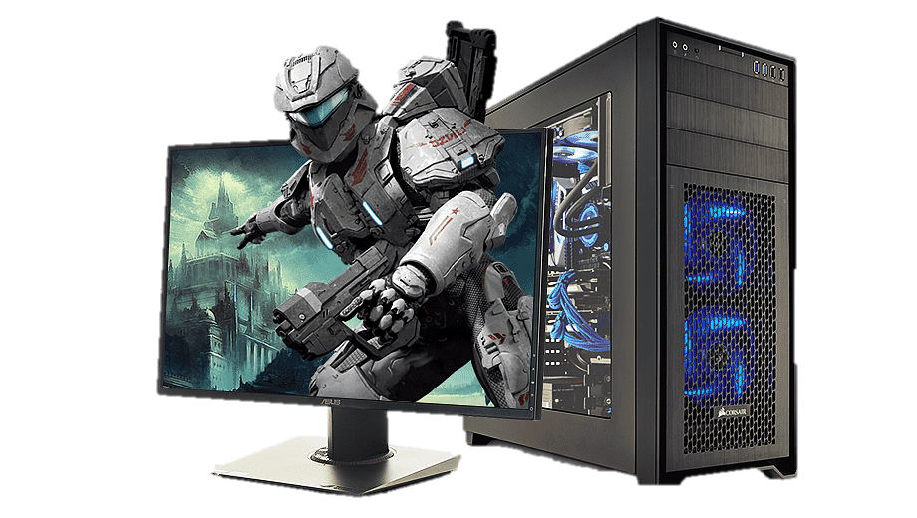
Our website:
Our website contains these components:
Main Page-
Products-
About-
Cart-
Log in interface-
Sign up interface-

Slide 3
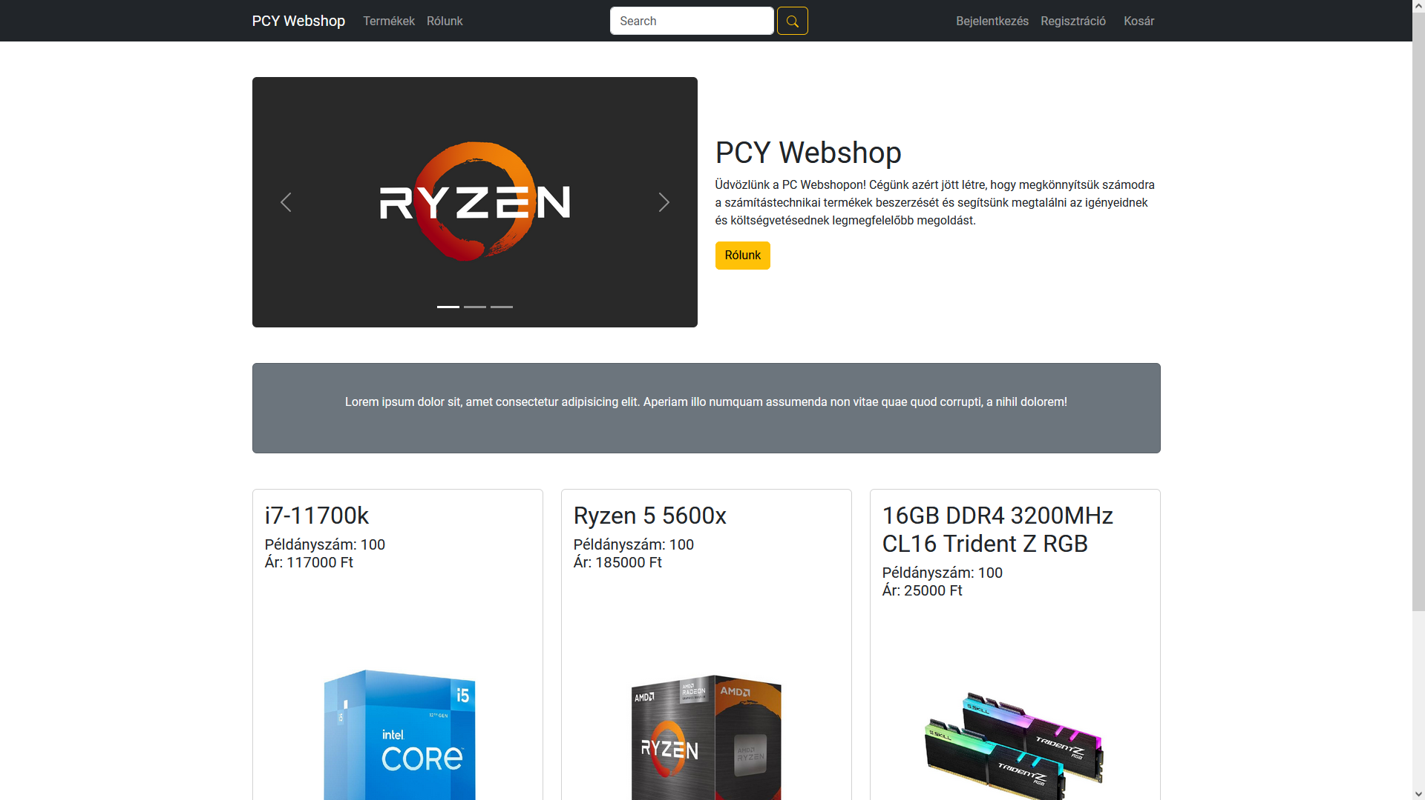

Main Page
Here we have a bunch of options, like the products page or the about page, we can also see the top selling products of the month at the bottom of the page.

Slide 4
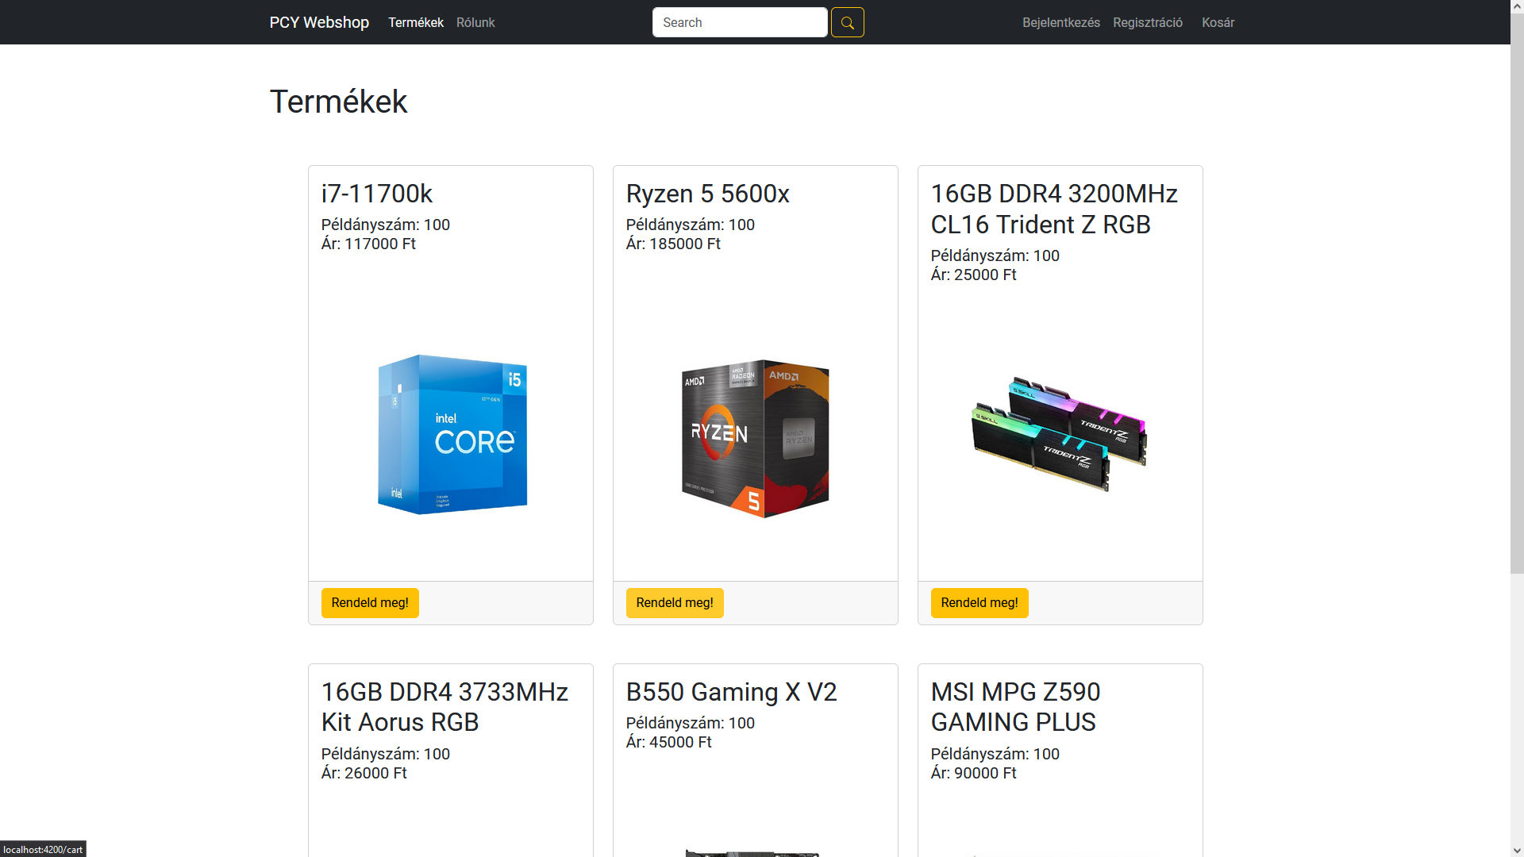

Products
Here we can order from a large pool of products, and we can also see images of them.

Slide 5
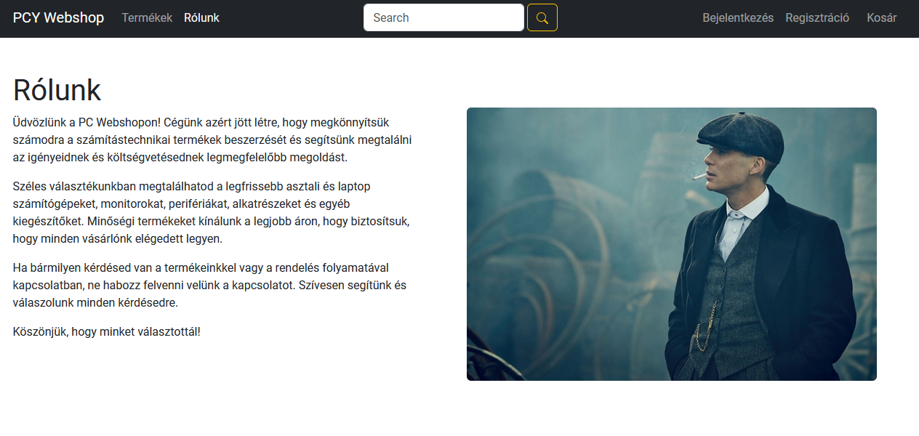
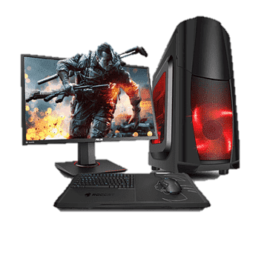
About
This is the about tab, here you can see some information about our website.

Slide 6
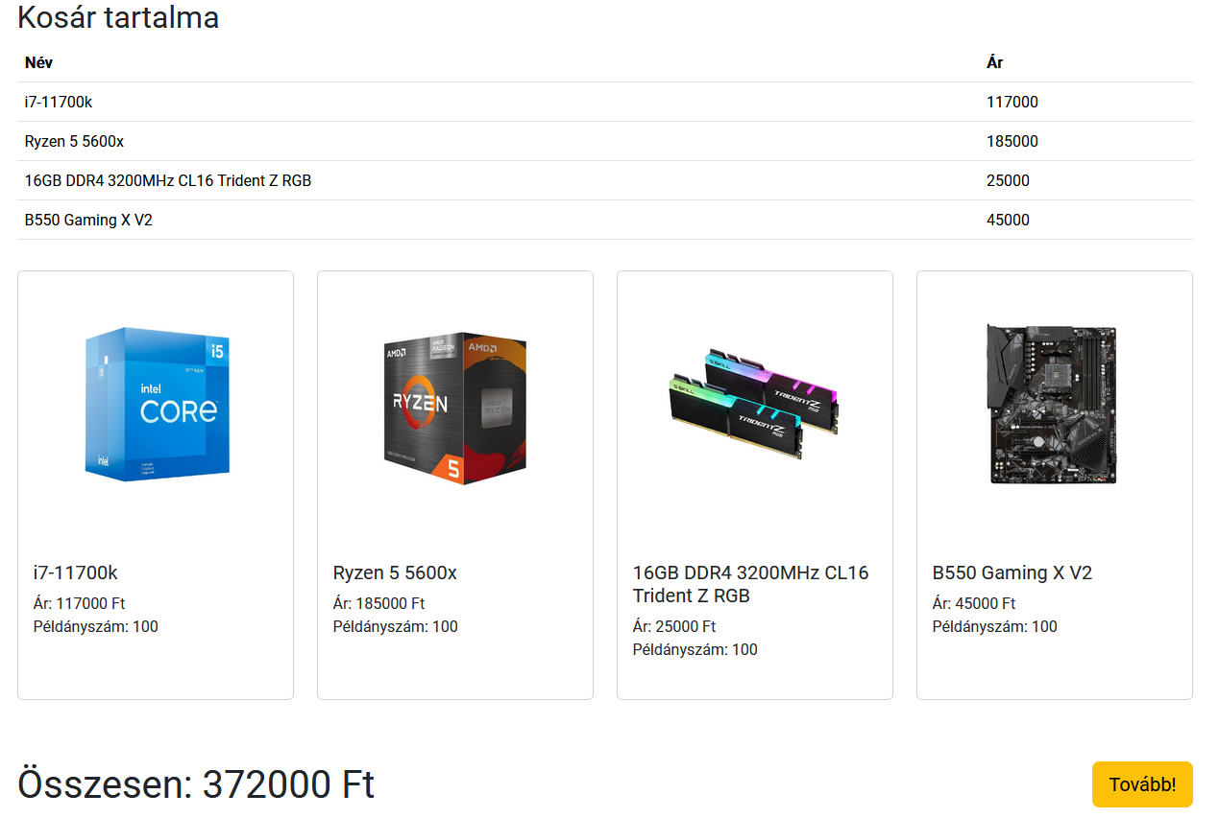
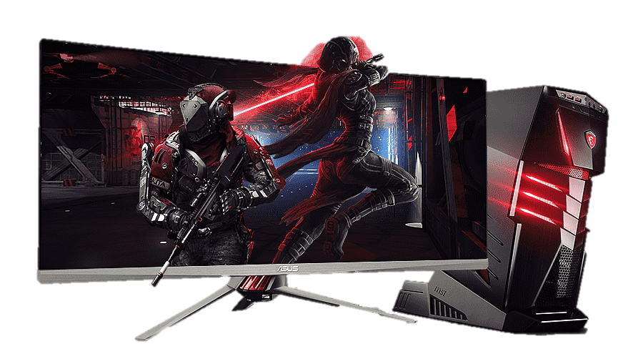
Basket
Here you can see those products that you added at the products tab, and you can also continue the process to the checkout page.

Slide 7
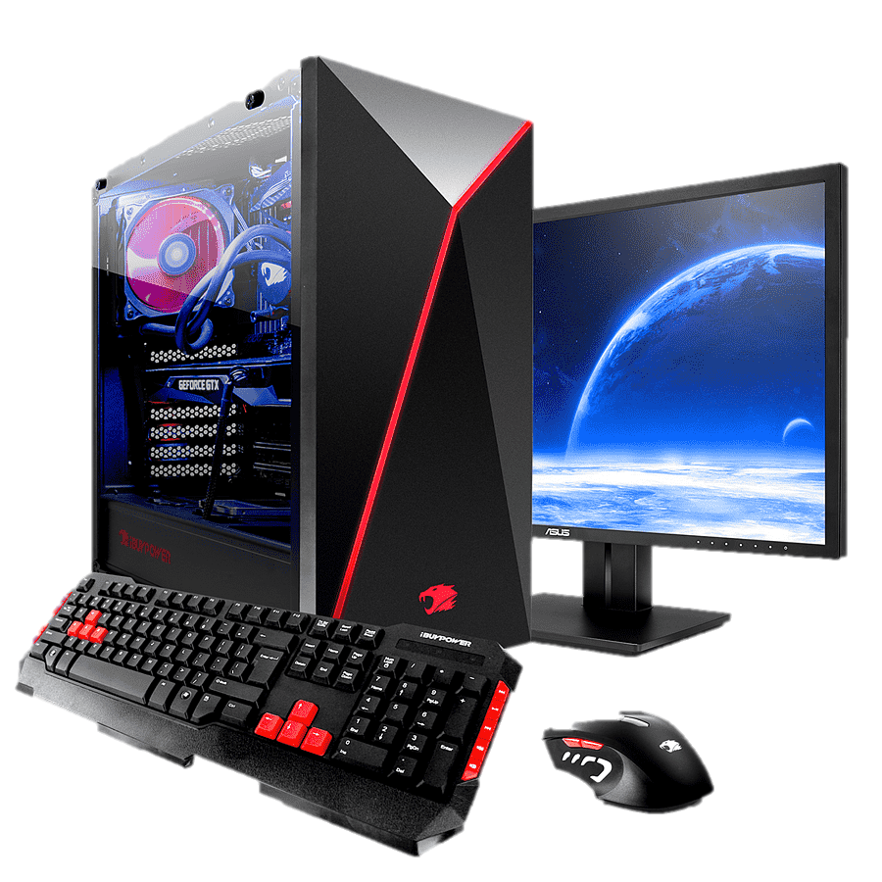
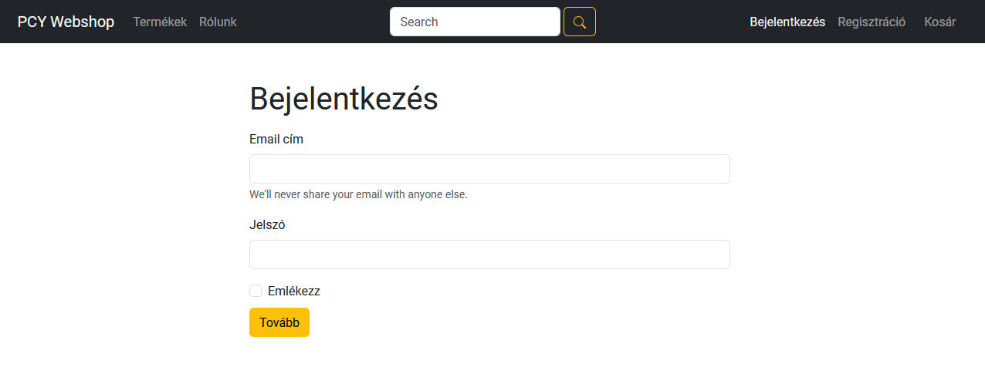
Log In and Sign up interface
This is the Log in interface, here we can Log in to our account, so the ordering becomes easier, and we can also track our package.

Slide 8

Thank you for your attention!!!
☺

